Slide 1
Progress Report: Nakuja N3
AIRFRAME TEAM • 02.15.2023

Slide 2
Overview
Expected delivery
February 15th,2023
Recent progress
3D printing of the avionics bay#21
Revision of the parameters#6
Finalise on the launchpad redesign.#22
Procurement of materials
Yet to be finalised
Procurement of fibreglass material and Aluminum

Slide 3
Progress - 3D printing of some parts of the Avionics bay
Accomplishment 1
We already started printing the avionics bay
Some of the parts were complex so, we chose to 3D print them instead of laser cutting
To do
Finish the printing and lias with avionics to see how things fit in
Proceed with laser cutting the e-bay platform as it was too big for the ultimaker 3d printer.

Slide 4
Progress - Revision of parameters
On-going
The revision of parameters is still ongoing, final results will be posted before the end of the week.

Slide 5
Progress - Finalise on Launchpad design
The previous launchpad pad structural design could not hold , we therefore embarked on re-designing a better more stable launchpad with a solid base.
The current blast deflector design is better and with a better surface area and shape design to maximally redirect the flames away from the ground and launchpad during launch.

Slide 6
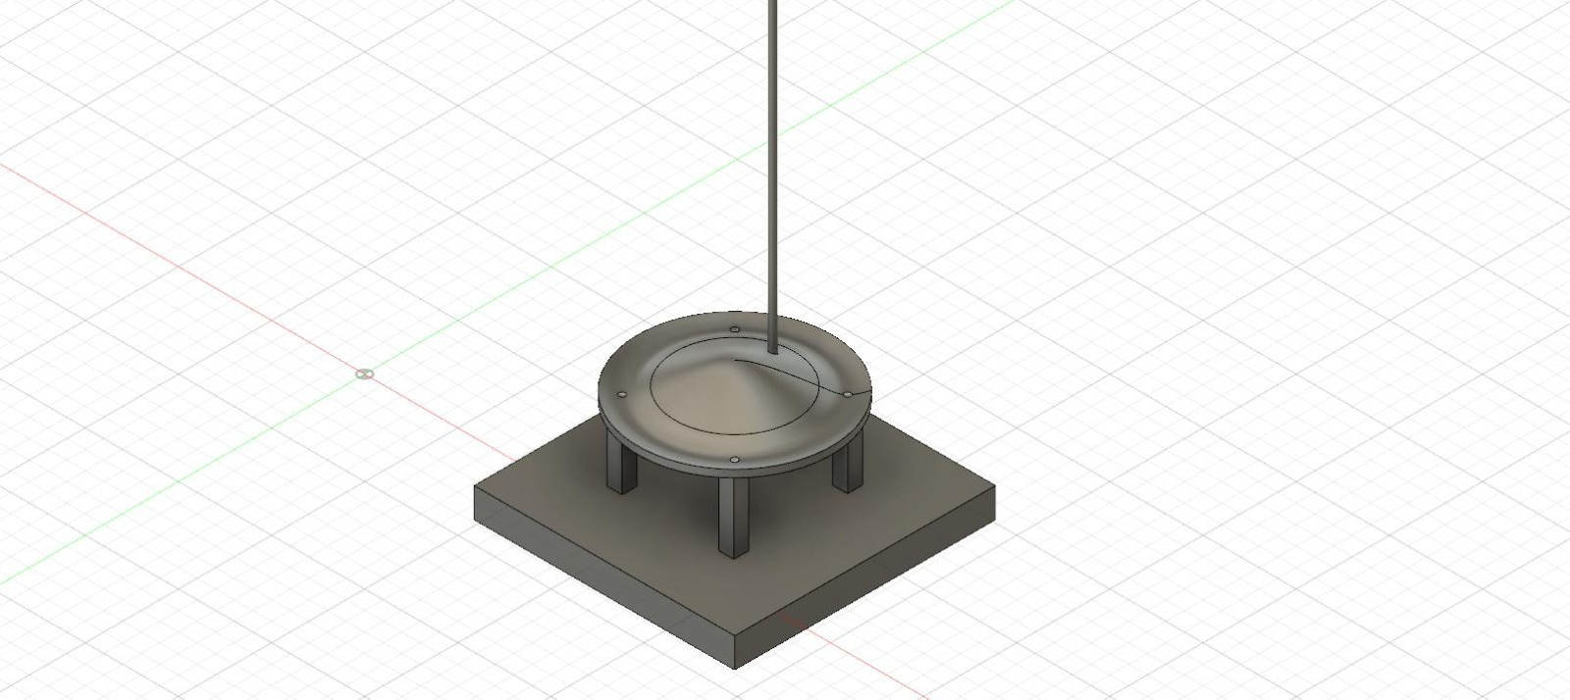
Launchpad design on fusion 360
Blast deflector material→ The engine exhaust expected to reach 1600℃. Stainless steel Grade 430 can withstand upto 1500℃. Refractory material to be applied on surface.

Slide 7
Progress - Procurement of Materials
13/2/2022
Visited the Silvercoin business park Hydro Aluminum company, aiming to inquire for the Aluminum tubes. However, 80mm not being a standard size, we could not get the targeted tube.
Consequently, we now opted to go for the Aluminum sheet instead.

Slide 8
Progress - Procurement of Materials
14/2/2022
Made a few calls, we were able to get Aluminum sheets from Industrial area;
The following are the prices and dimensions of the available sheets in the companies we reached out to:

Slide 9

Progress - Procurement of Materials
14/2/2022: Bill Of Materials

Slide 10
Attention areas
1
Finalise fabrication of the Avionics bay
Procurement of aluminum and fibreglass materials.
2
Documentation and settling on the rocket parameters before end of week

Slide 11
Goals for next week
Fabrication of the airframe(Fiberglass)#20
Revision of the parameters#6
Design of the fin alignment jig#23

Slide 12
THANKYOU

